Slide 1
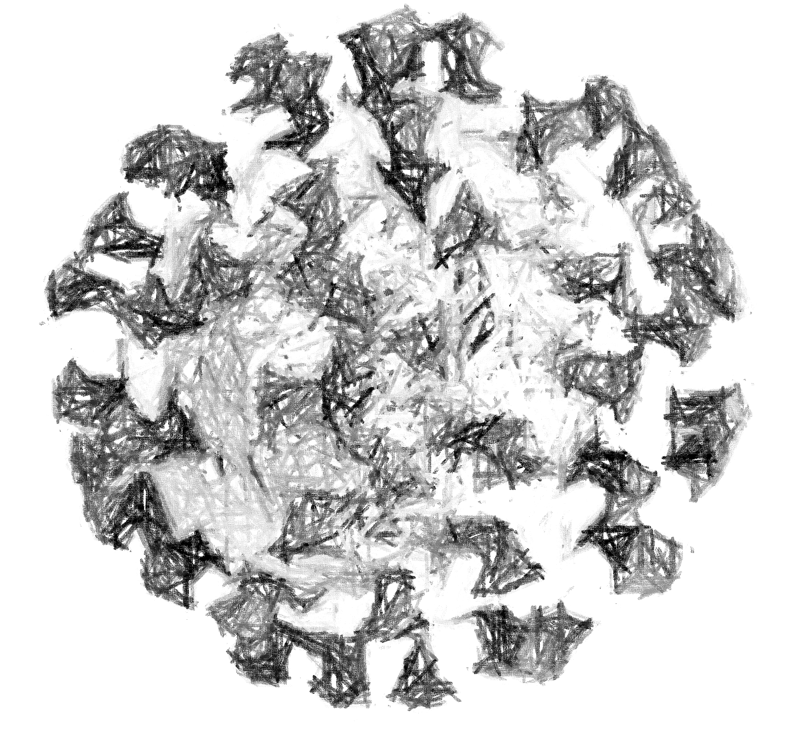




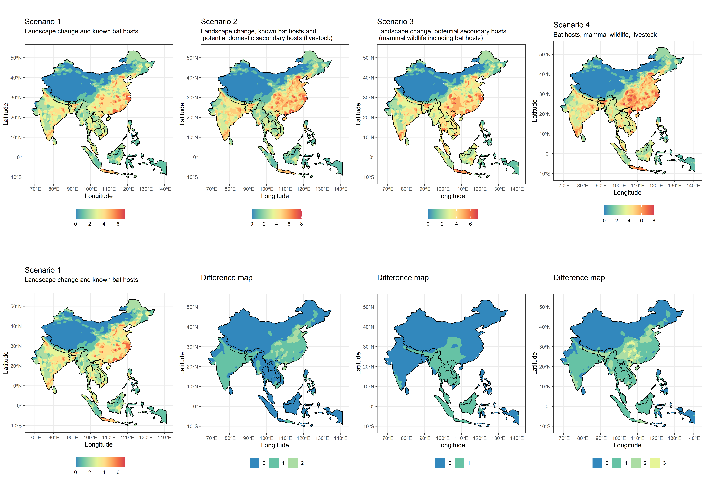

Slide 2
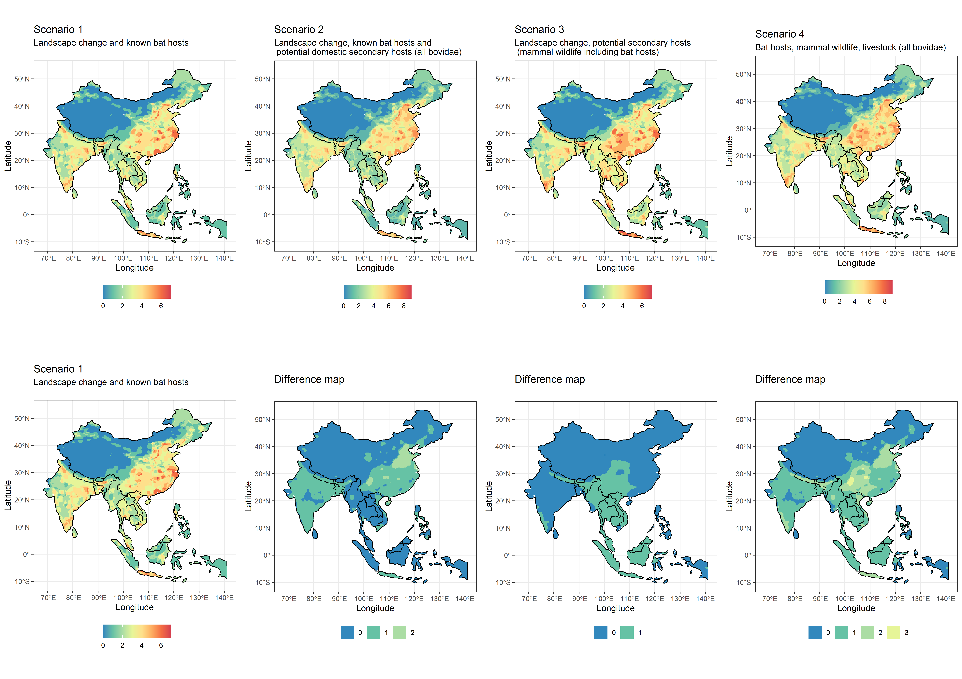

Slide 3
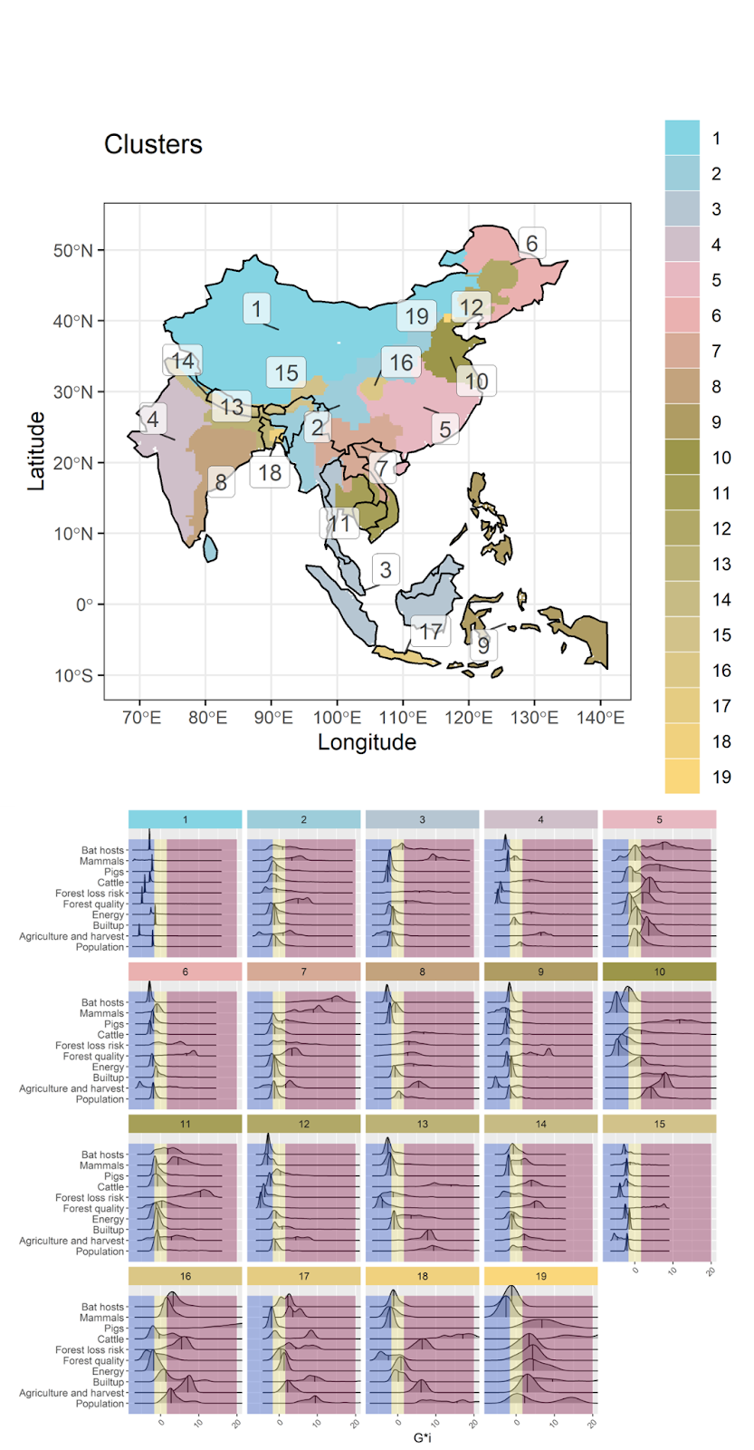
Cluster general geographical region names (indicative)
1 Inner-West China
2 Assam, West Burma block, Steppe, Sri Lanka
3 West Thailand, most of Sundaland islands
4 West India
5 Central China
6 Manchuria
7 North Lao PDR, North Vietnam, South China
8 East India
9 Philippines, Timor East, West Papua
10 North China
11 Southwest Indochina
12 Inner Manchuria
13 Nepal, Bhutan, Bangladesh
14 North India
15 South Lhasa and Arunachal Pradesh
16 Yuzhong District, Chongqing
17 Java
18 East Bangladesh
19 Beijing

Slide 4
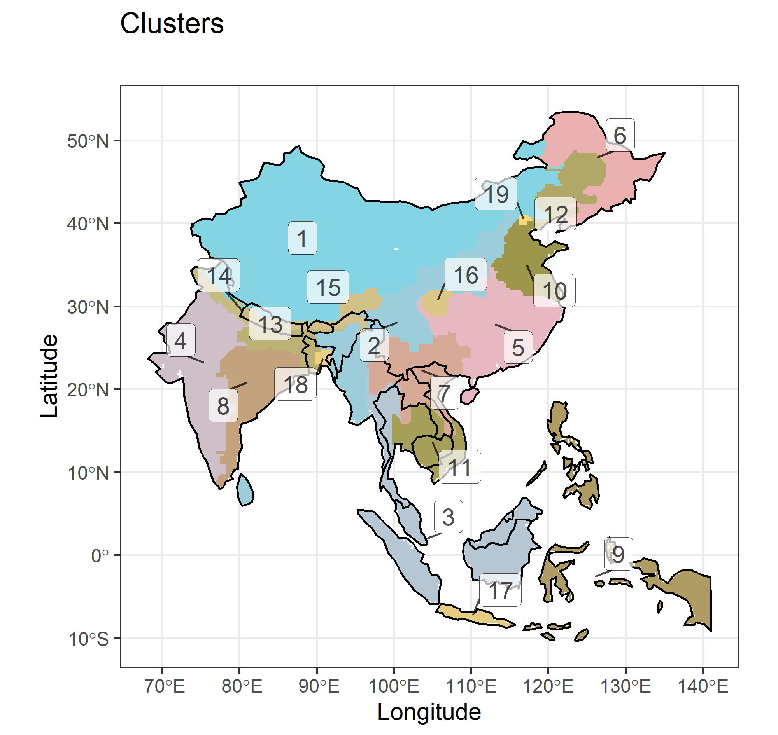
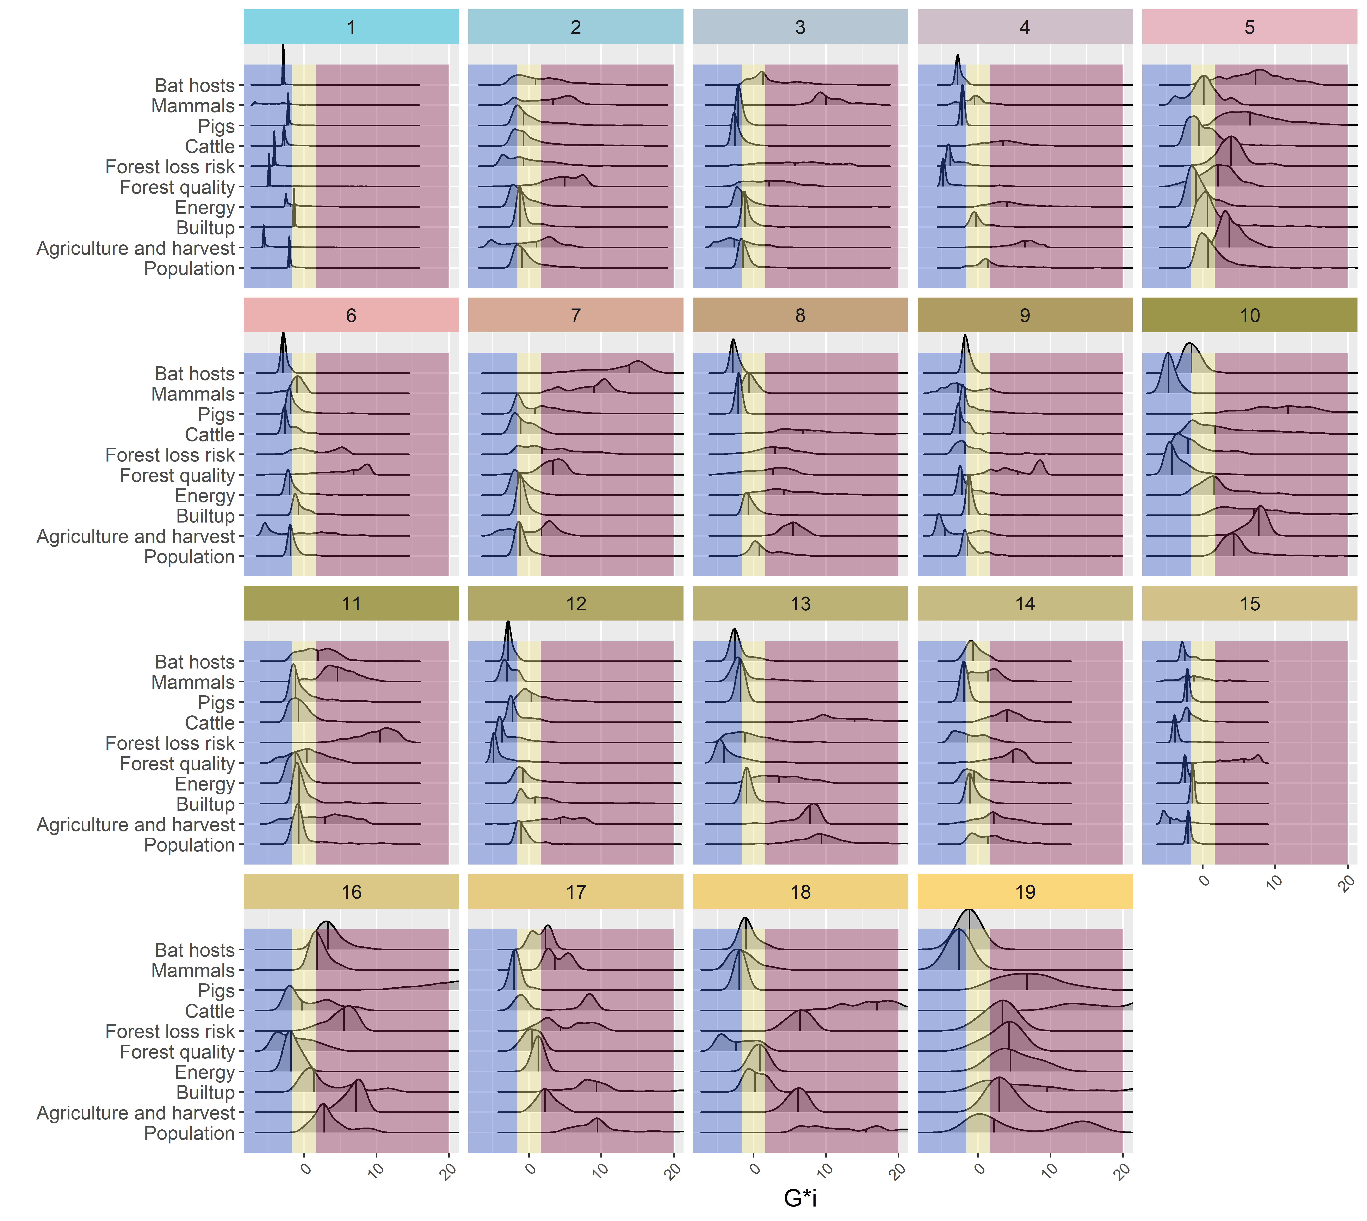

Slide 5
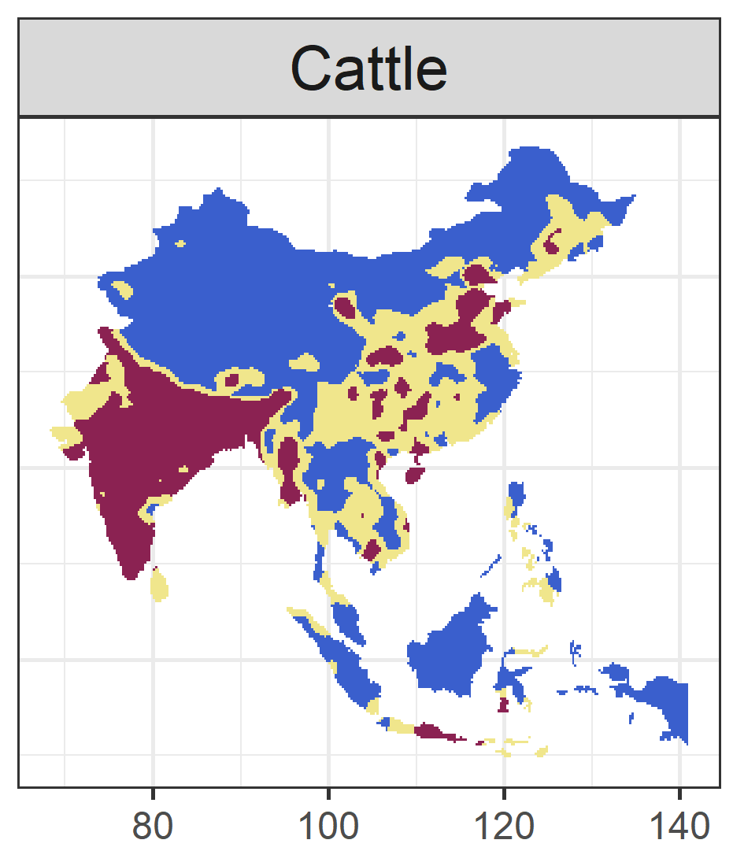
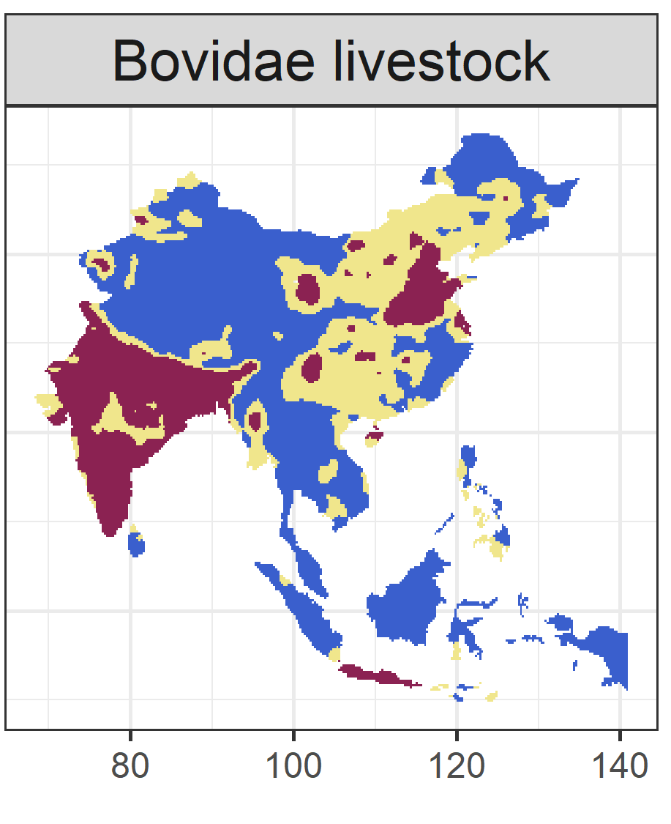



Slide 6
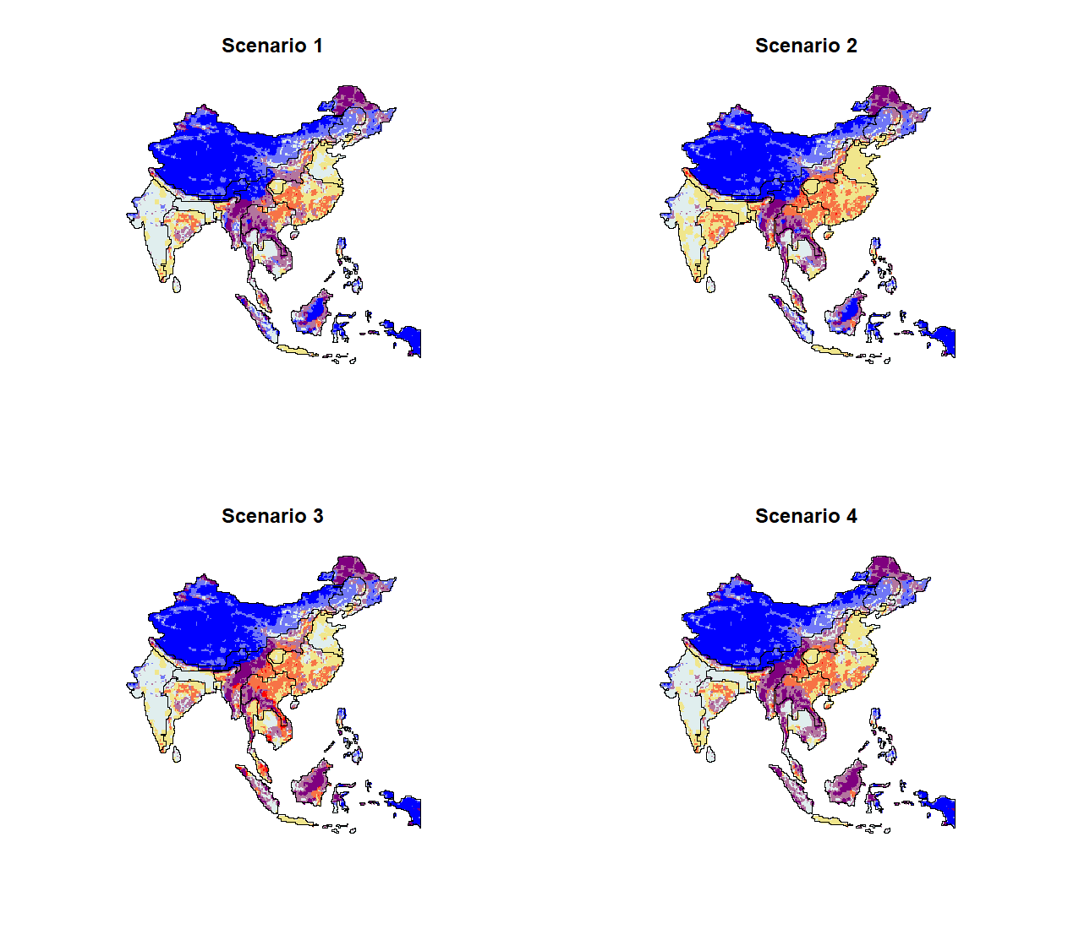
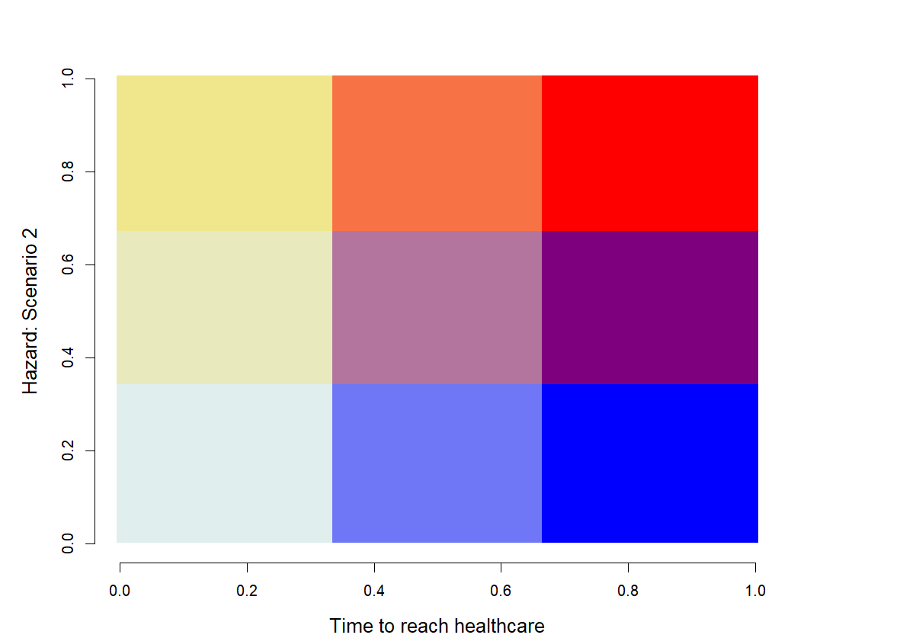
- Risk +
- Time to healthcare +

Slide 7
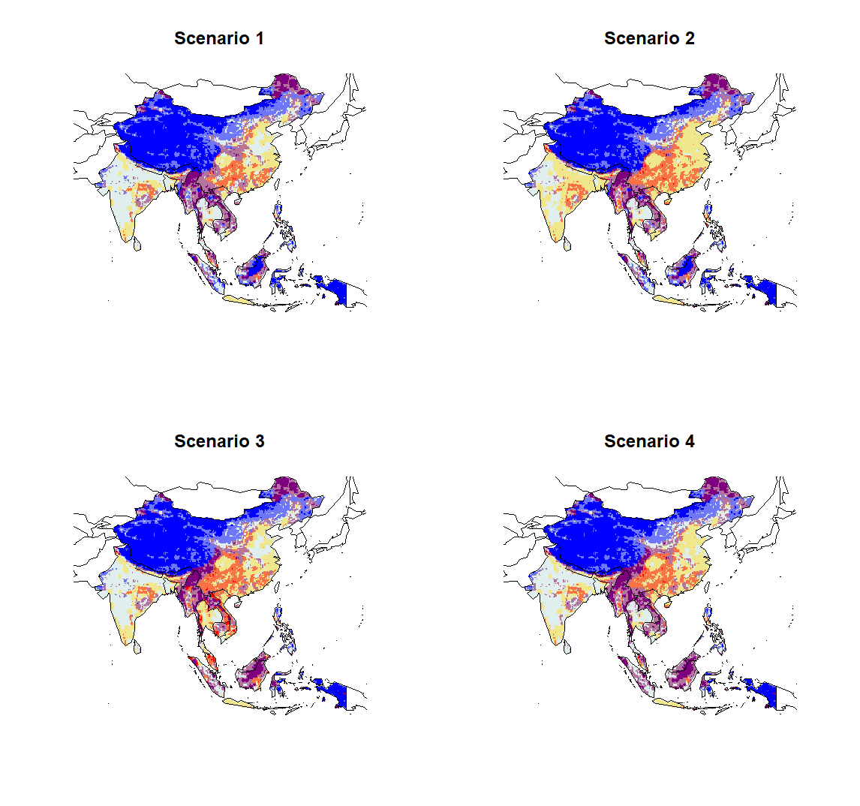
- Risk +
- Time to healthcare +

Slide 8
3
9
12
- Risk +
2
8
11
1
7
10
- Time to reach healthcare +

